Slide 1


Introduction to quantum programming
With Qiskit
PRESENTED BY
Maria Gragera Garces
Q-volutio
DATE
29/07/2025
Notes:
Too little time
Speaking too fast – give more info my projects
A lot of text – too small and that I don't reference
Fix resolution slide 1 images
Make clear testbed and overview on research (transition slides)
Big picture at the start (bubbles) and show connections
-> pickpoint info

Slide 2
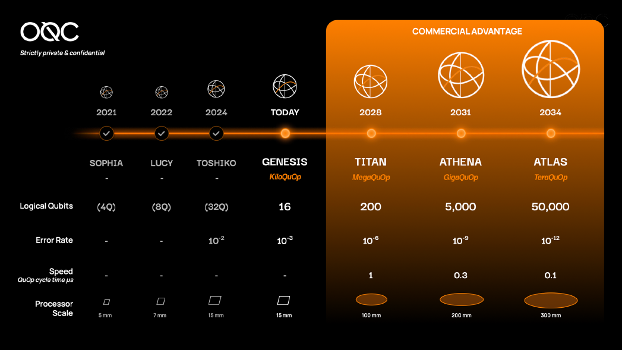
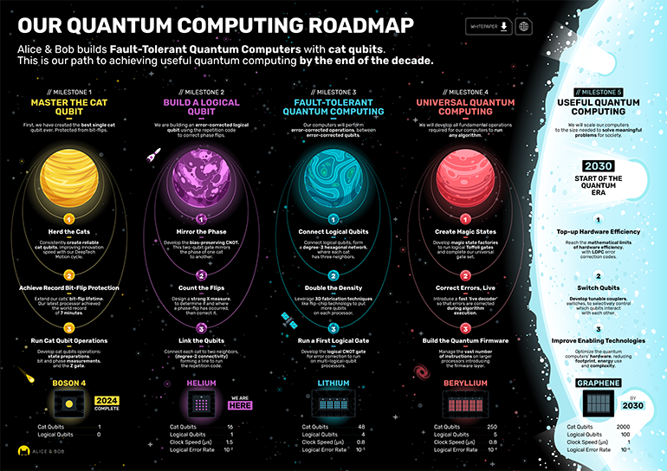
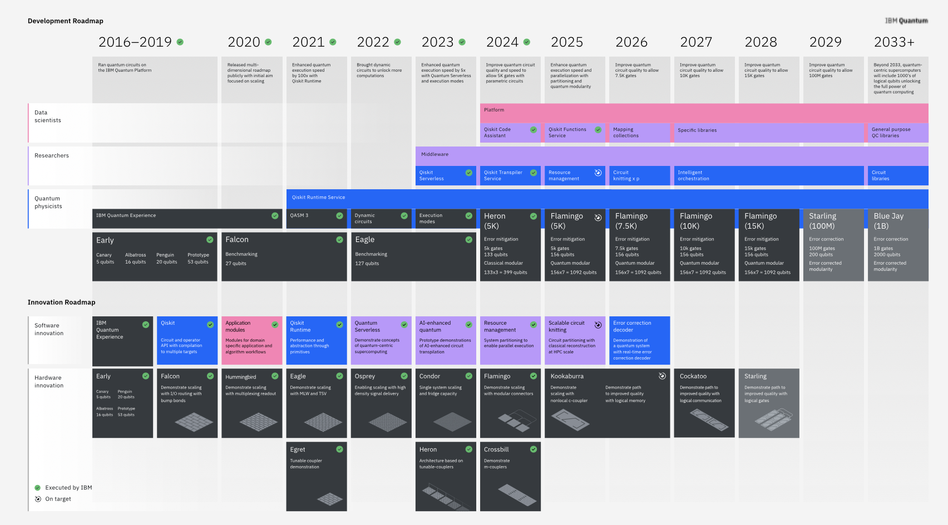
State of the art: what we have
+100 qubit regime” “usefulness”

Slide 3
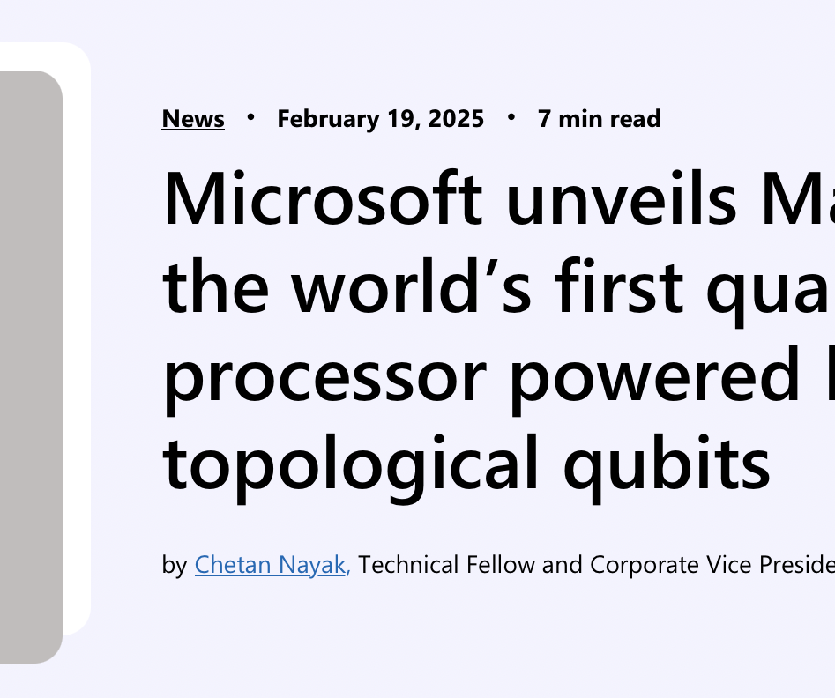

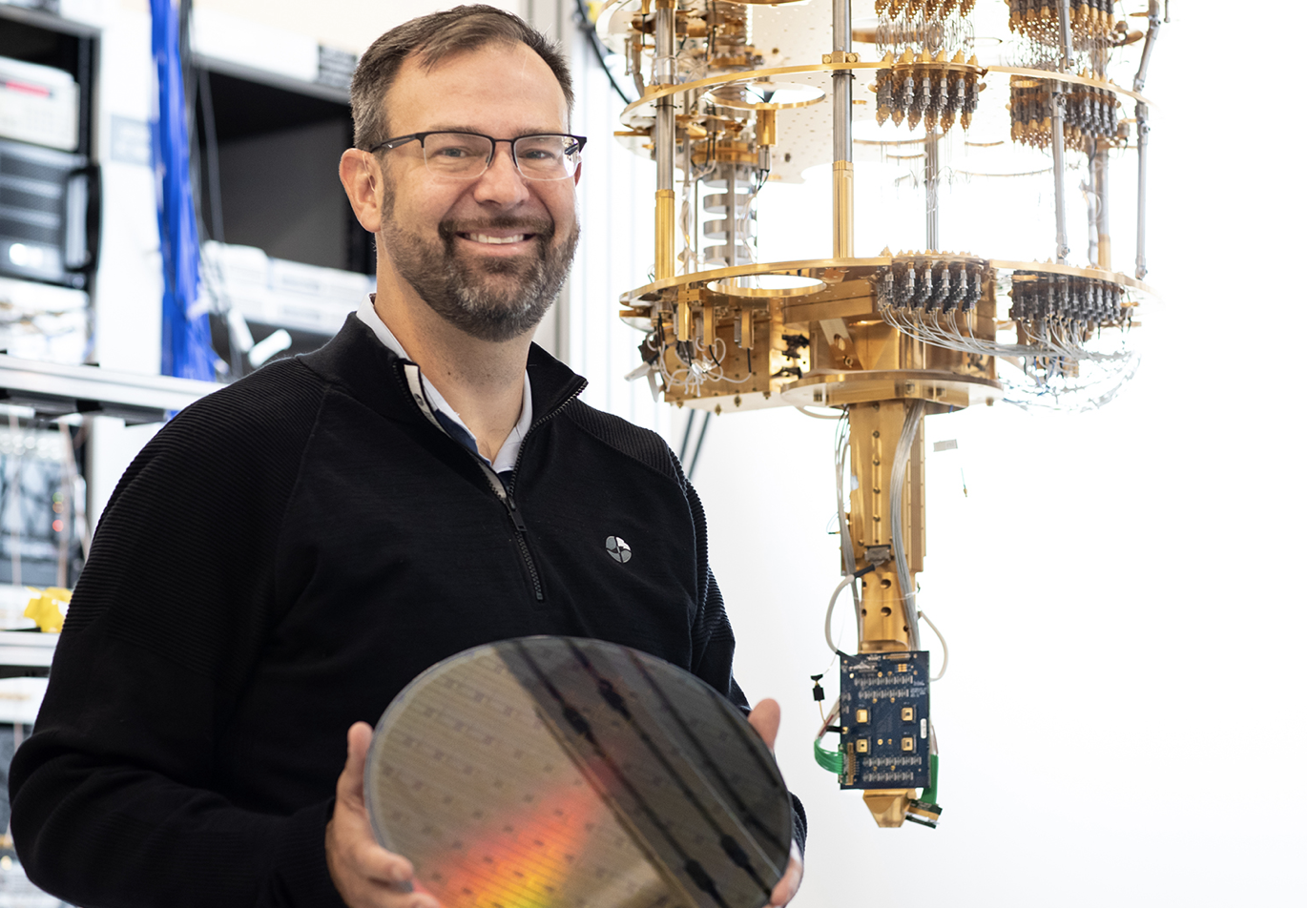
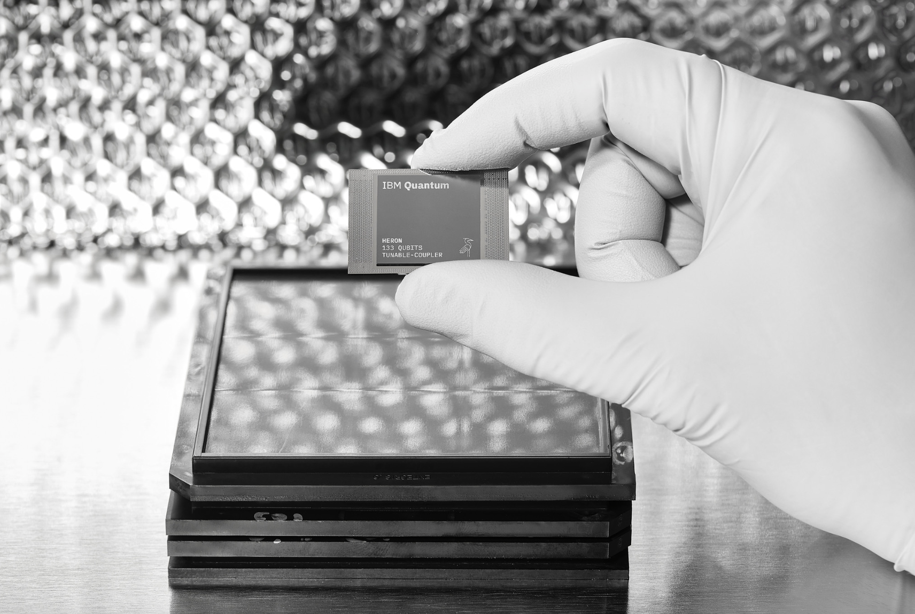

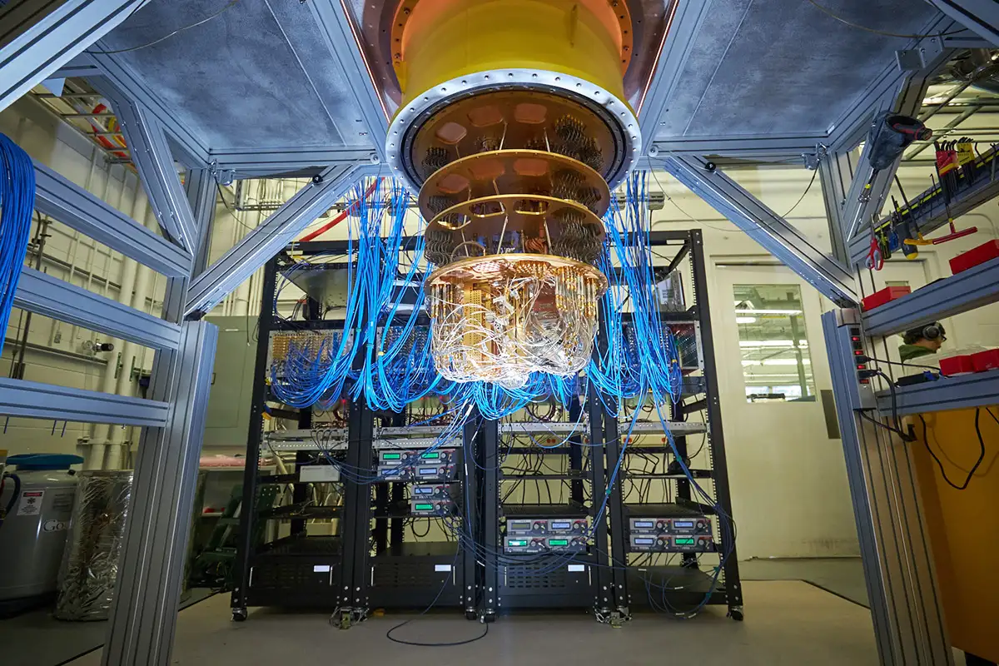
State of the art: what we have
+100 qubit regime” “usefulness”
Healthy ecosystem with many different devices

Slide 4



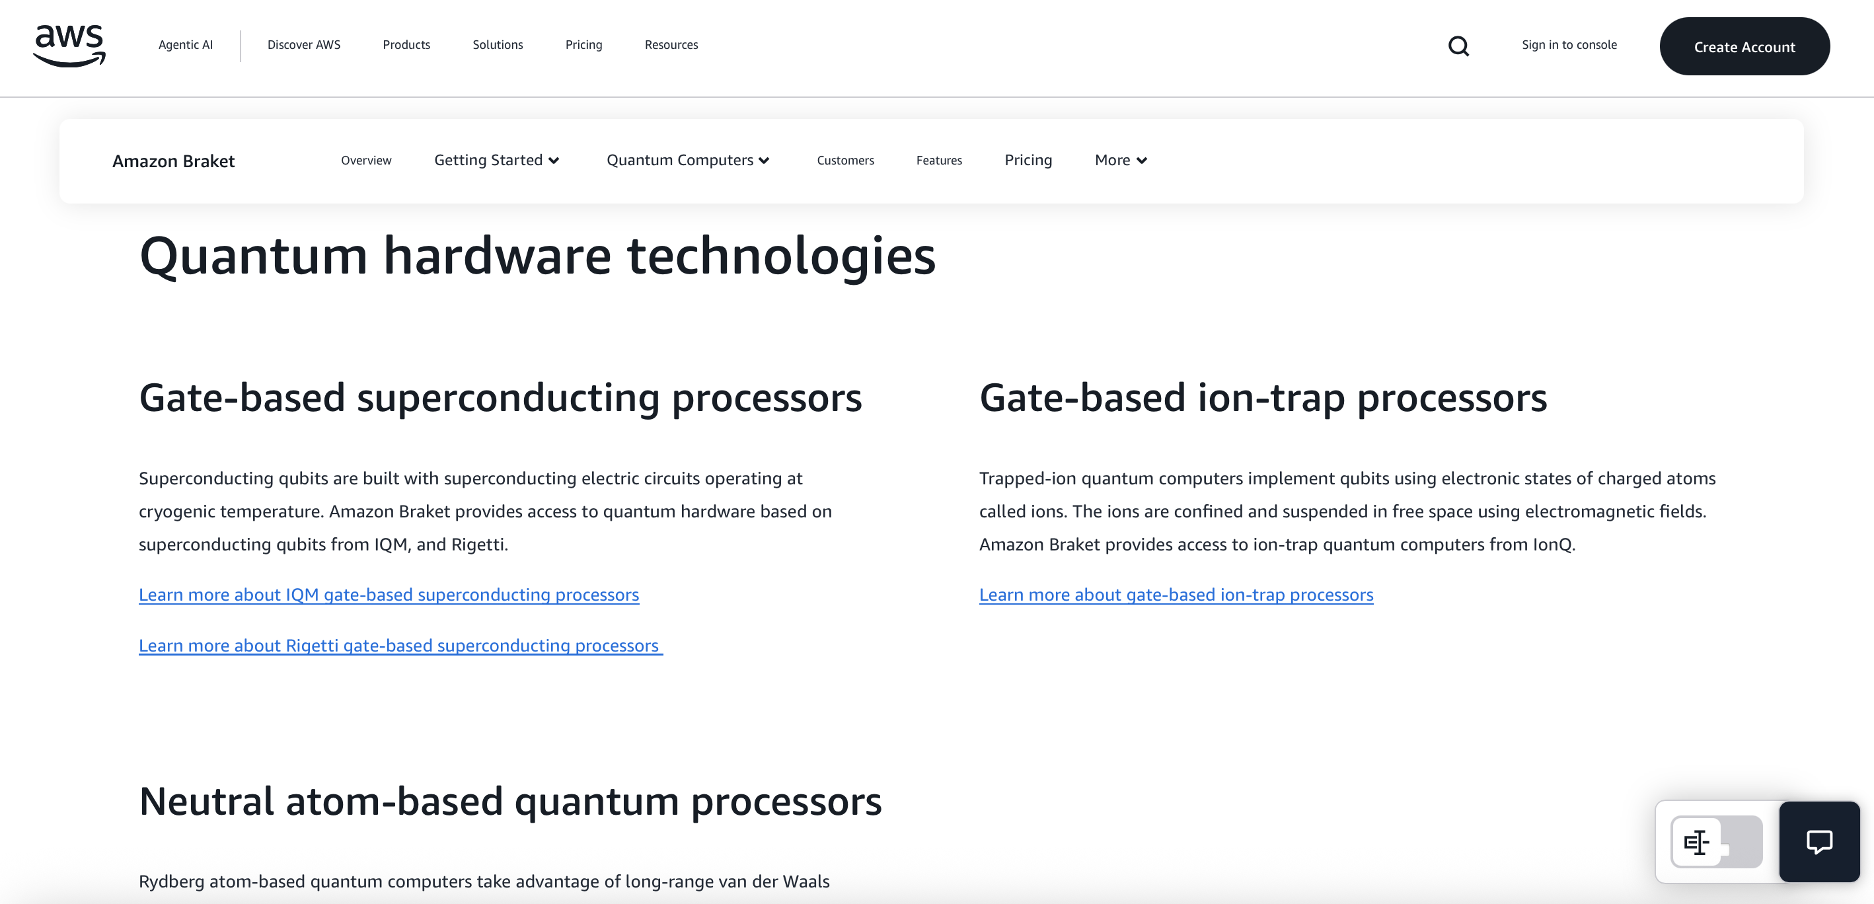


State of the art: what we have
+100 qubit regime” “usefulness”
Healthy ecosystem with many different devices
Various publicly available quantum services

Slide 5

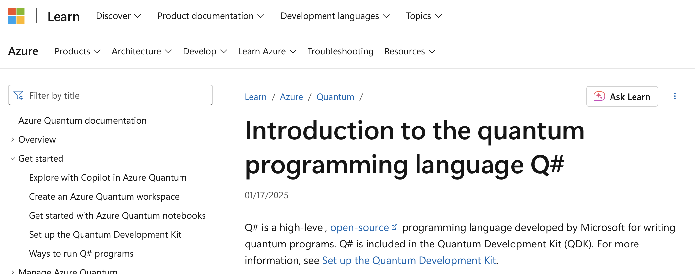



SDKs: software options

Slide 6

Accessing real machines
Device time can be as costly as 5000$/hour

Slide 7
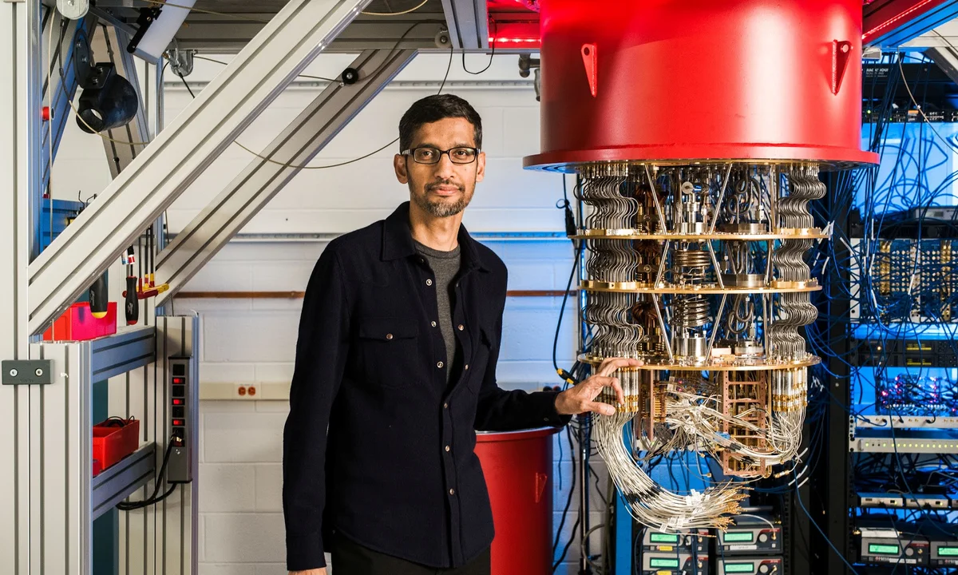
Accessing real machines
Device time can be as costly as 5000$/hour

Slide 8
Accessing real machines
Device time can be as costly as 5000$/hour

Slide 9
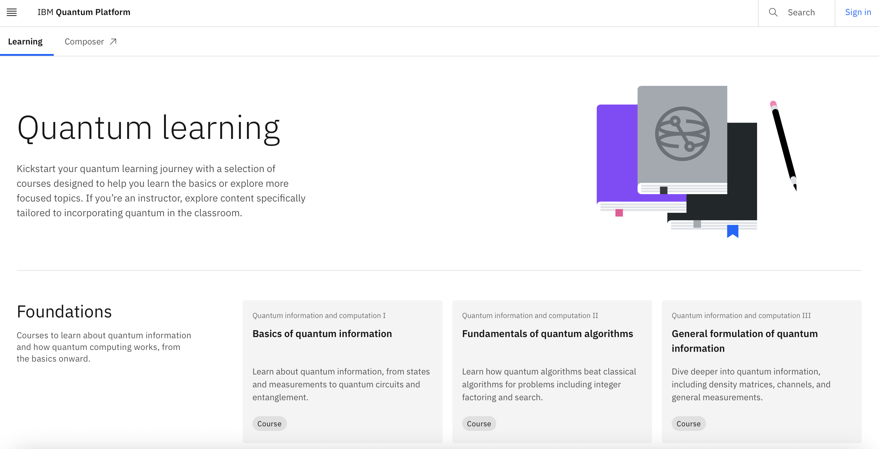
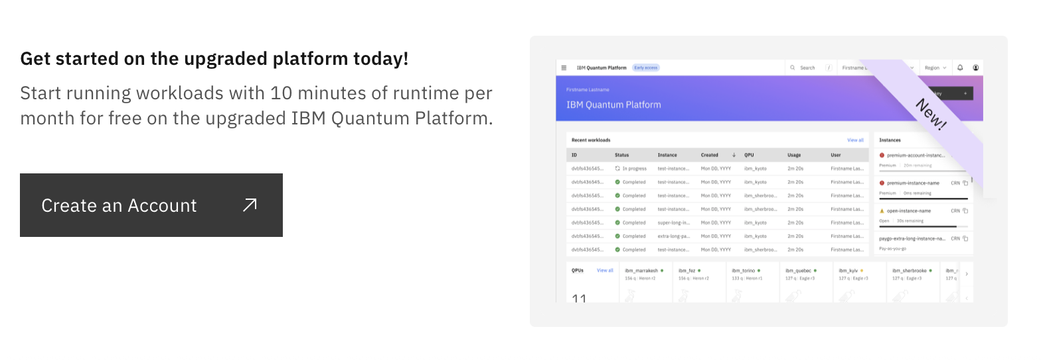
My recommended intro: Qiskit
https://quantum.cloud.ibm.com/learning/en

Slide 10

My recommended intro: Qiskit
https://quantum.cloud.ibm.com/learning/en

Slide 11
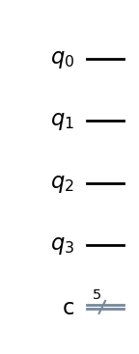
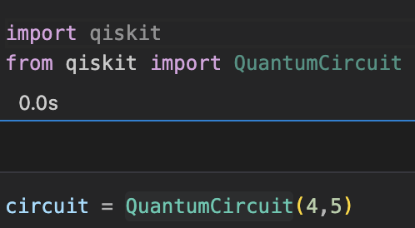
Initializing qubits: the start
qubits
bits

Slide 12
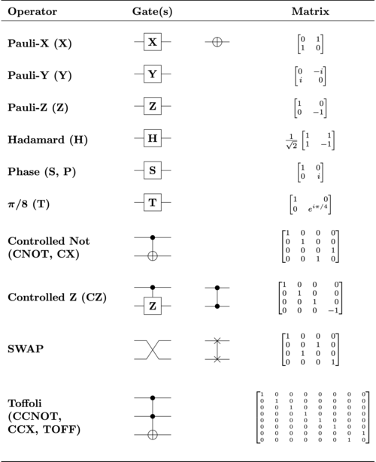
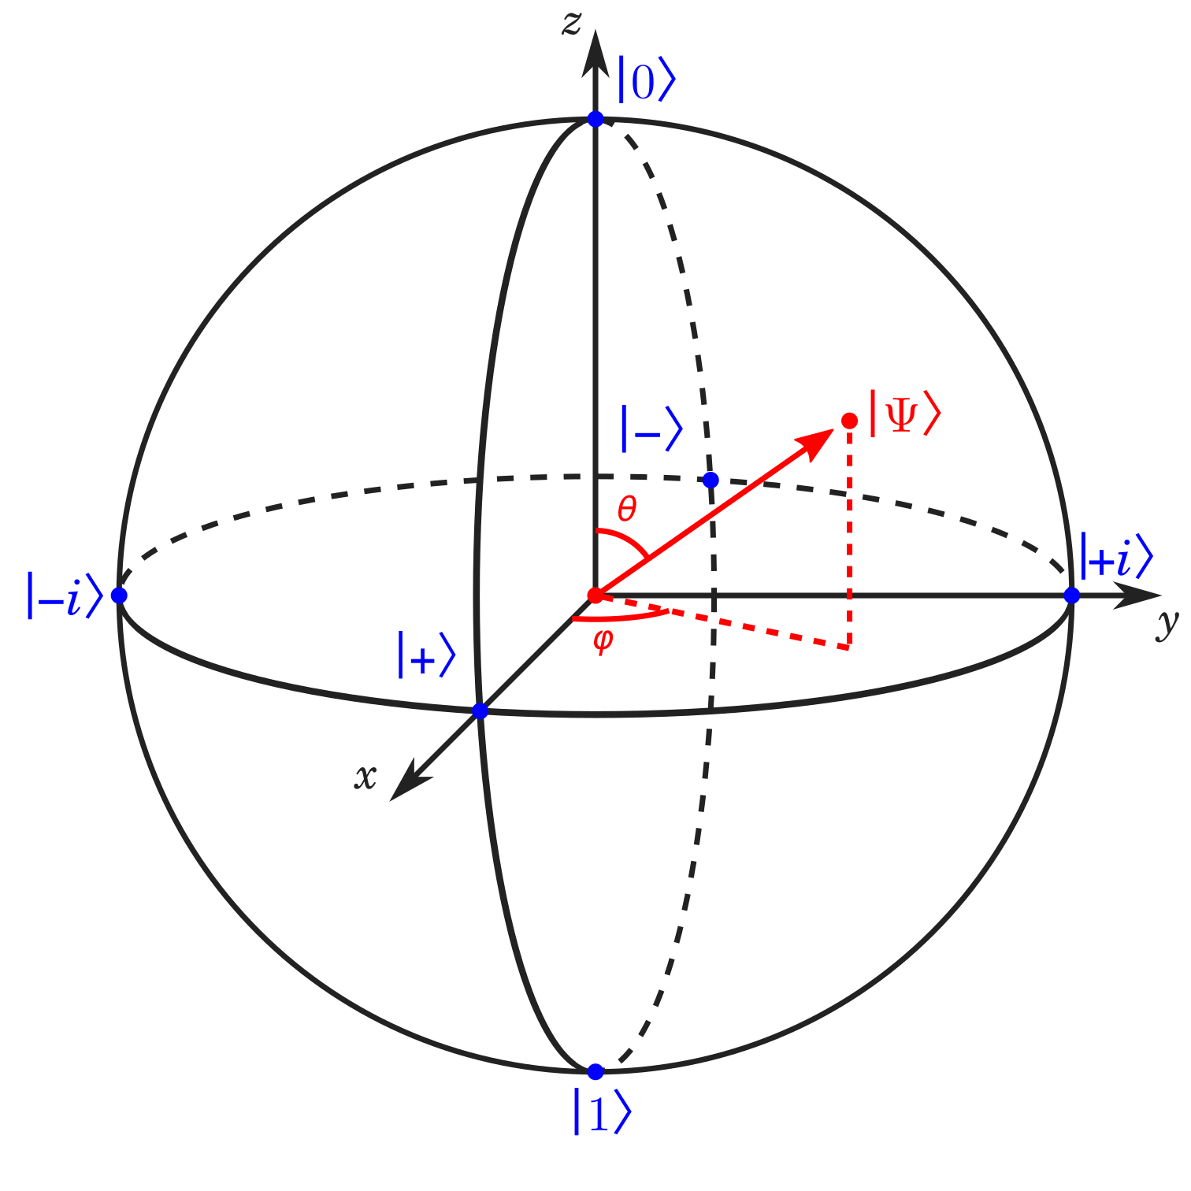
Gates: computation operations

Slide 13
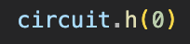
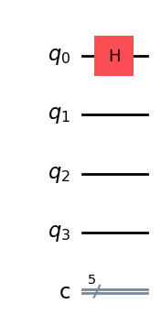
Gates: computation operations

Slide 14
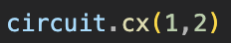
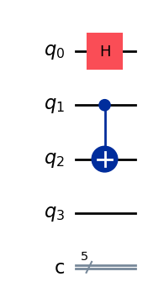
Gates: computation operations

Slide 15
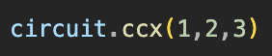
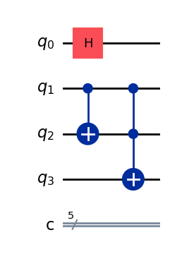
Gates: computation operations

Slide 16
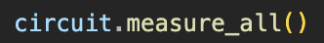
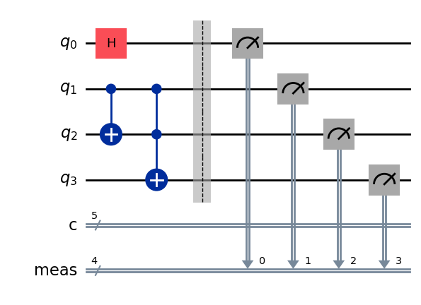
Gates: computation operations

Slide 17
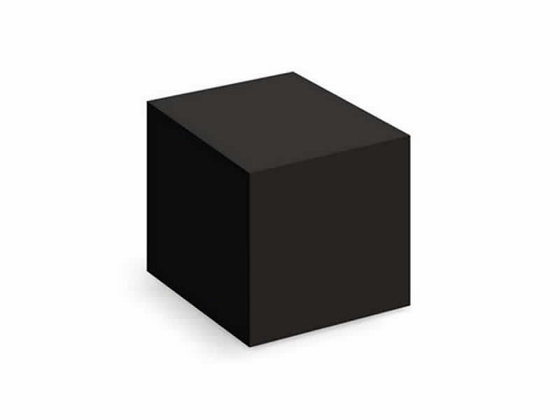
Your first quantum algorithm: Deutsch-Jozsa
Provides an exponential speedup compared to classical computers.
Input
Output: True, False
Oracle

Slide 18

Your first quantum algorithm: Deutsch-Jozsa
Provides an exponential speedup compared to classical computers.
constant function: always behave the same regardless of input -> always true or false
balanced function: will return true for half of the inputs, and false for the other half -> 50% true, 50% false

Slide 19
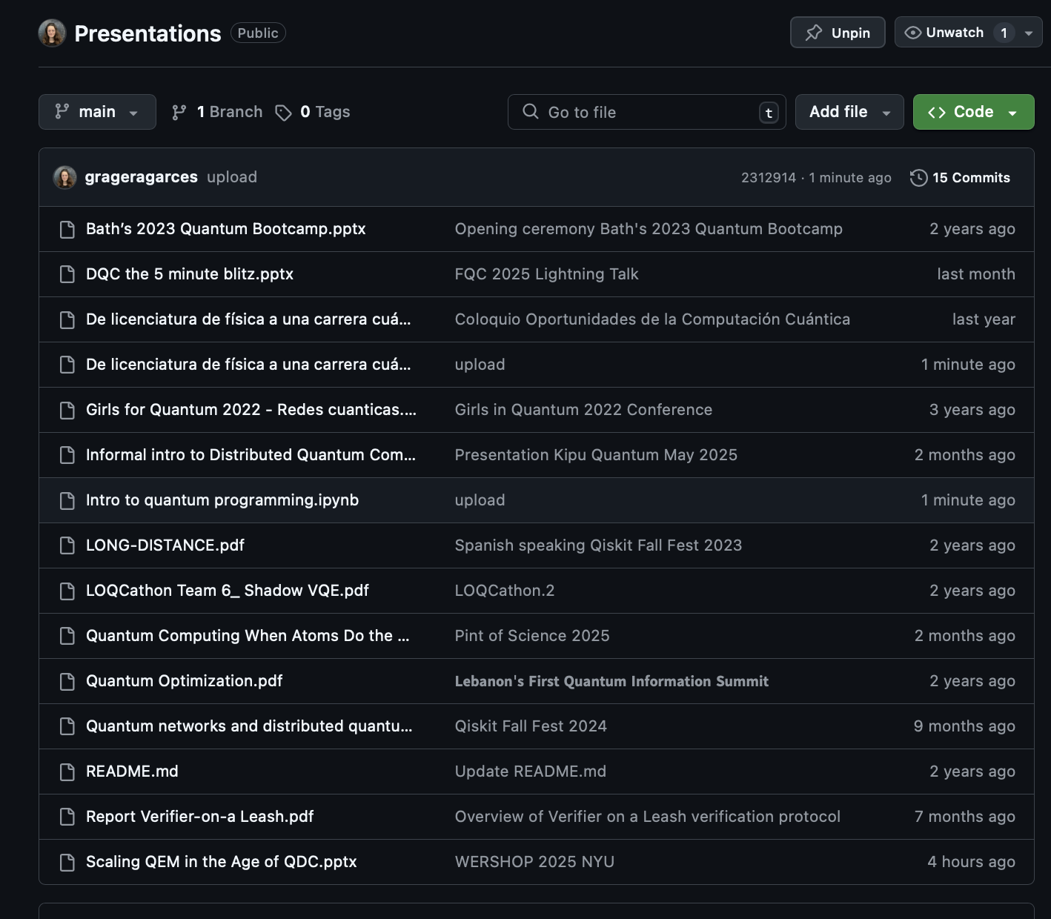
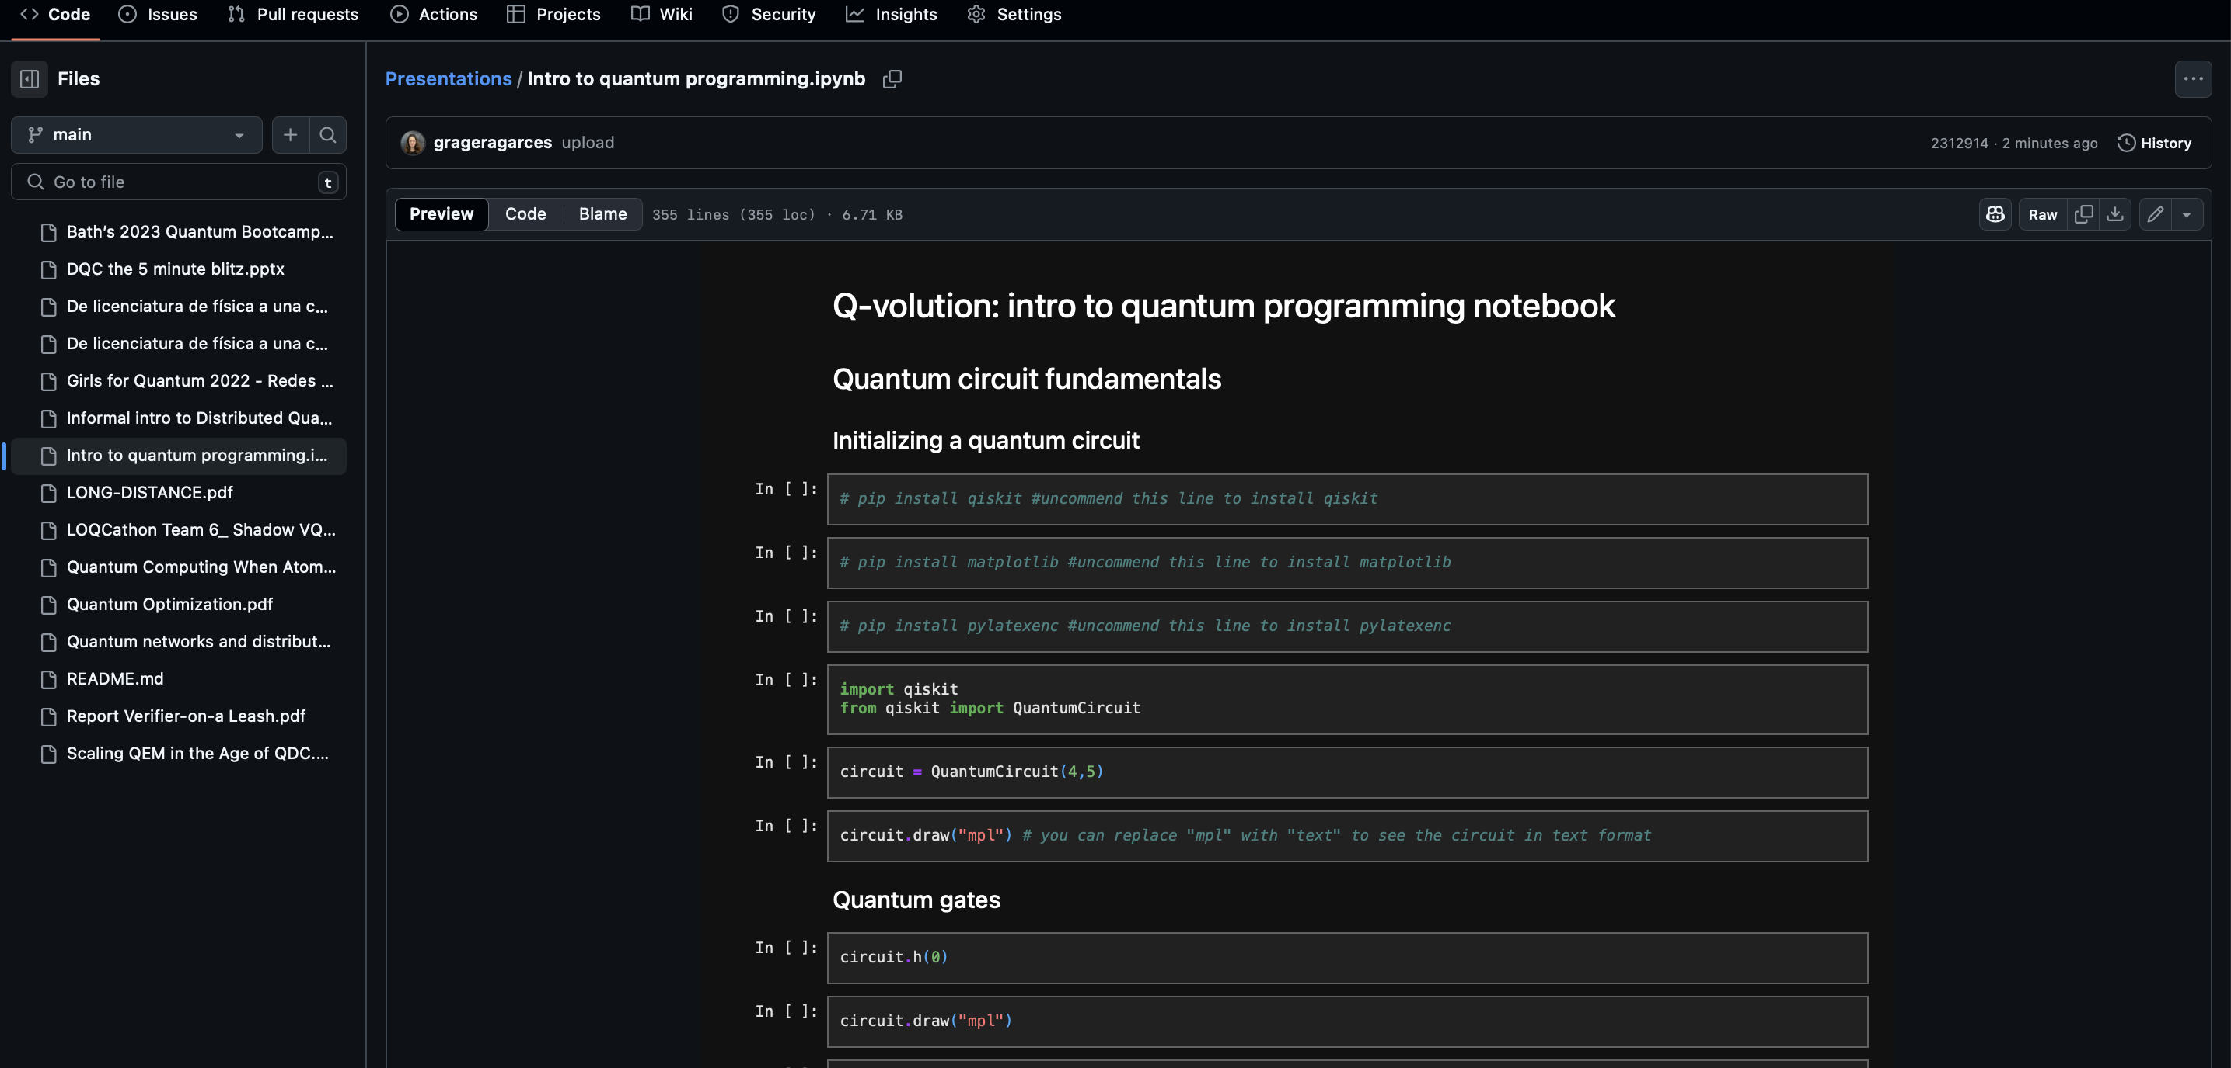
Let’s play with some code
https://github.com/grageragarces/Presentations

